Slide 1
Chinese life
乌鲁木齐 wūlǔmùqí

Slide 2
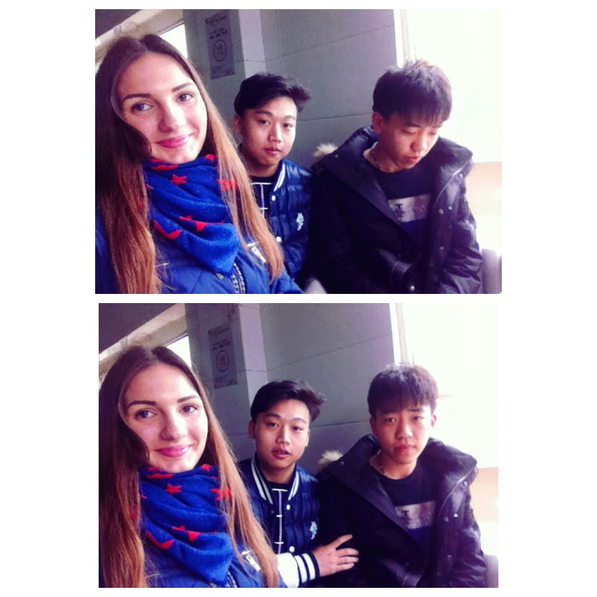
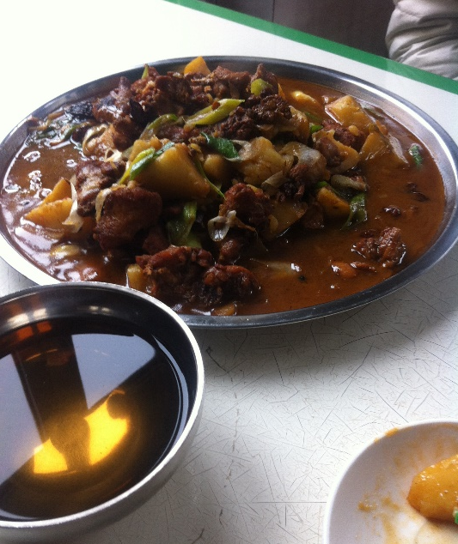
First impression
Today is my first day in China. Now I have a feeling that I don’t understand what happens with me. It’s like a moment of sleeping. I can’t imagine that I will come back home only in 4 months.. Nevertheless, it’s the truth, so I should spend my time with maximum benefits.
I would like starting describing my life with the apartment: I live in a dormitory for foreign students in a single room, it’s quite comfortable. I have a bed, a chair, 2 desks, a big cupboard, my own restroom, warm water and central heating.
Truly speaking it’s a really hard to live alone in China, as there aren’t people who can speak Russian, and only one person who understands English. Furthermore my Chinese vocabulary isn’t very wide, for instance I can’t solve problems with Internet without someone’s help. However, I surrounded by such a kind people!!! The man who is responsible for foreign students is Ghalip. He does his best to help me! Moreover, I have two bodies (boys in their 20s) who guide me for the first time. In addition, other Chinese are quite friendly and helpful.
Today I had a small walk by the territory of University, after that guys invited me to have a dinner. In spite of the fact that I’m not a big fan of Chinese food, they were succeeded to find really tasty potatoes with meat! Then we went to the police station to register as a foreigner and legal live in the territory of China. In evening Ghalip with his 3 cousins invited me to the bowling and we spent really good time.
I hope I’ll have a lot of positive days in that country.

Slide 3
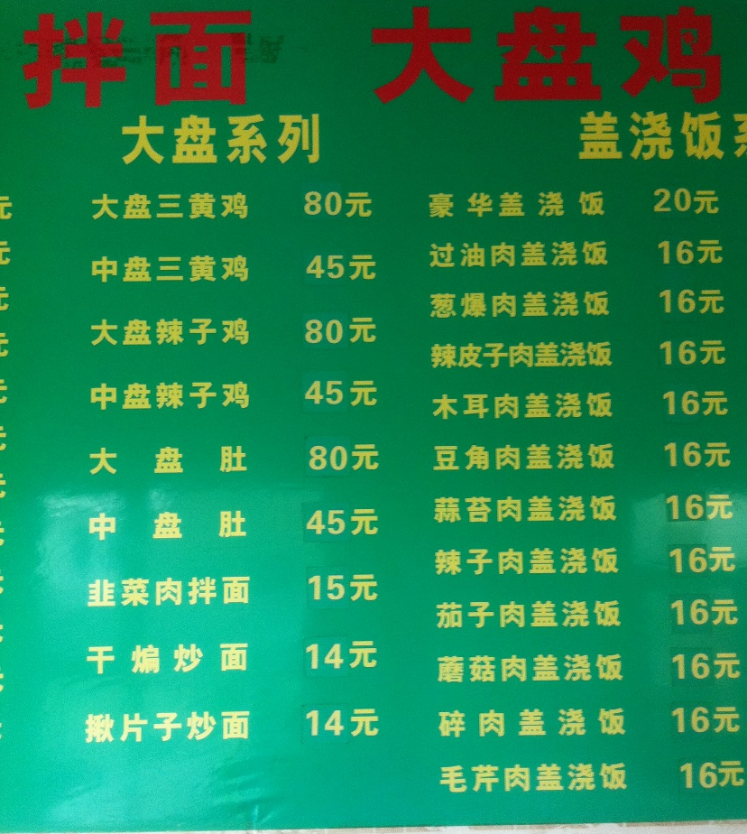
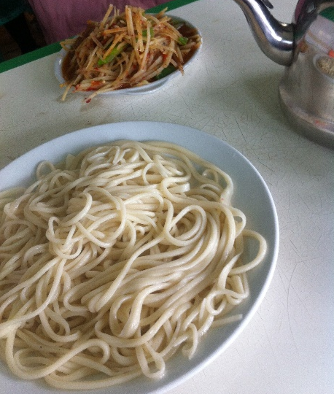
Who doesn’t learn Chinese that doesn’t eat
Today I understand that the best way to learn Chinese is to live in China without Russian friends. As the majority of Chinese can’t speak English and Russian of course too. Therefore, if you have a problem you should solve it using Chinese language. And it’s a great chance to quickly learn foreign language.
For instance, there isn’t menu with pictures in Chinese cafes. That way if you want to eat you should translate hieroglyphs at first.
When today I entered in the café I had seen two words that I had learned (土豆, 面 ). I ordered potato and noodles. Truly speaking it wasn’t very delicious: very spicy. But after that I took photos of all menu, translate it in my room and learn new words:
沙琪玛 shāqímǎ – Chinese sweets like puffed rice
茄子 qiézi - eggplant
葱 cōng - onion

Slide 4
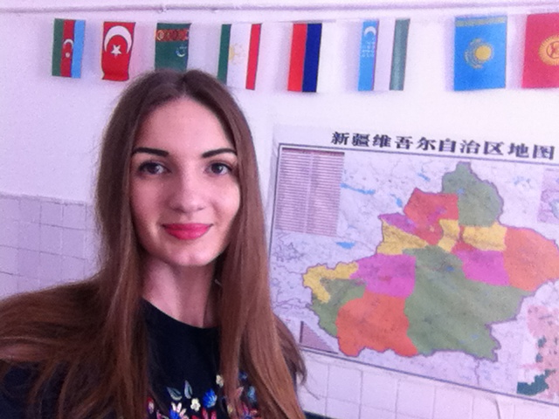
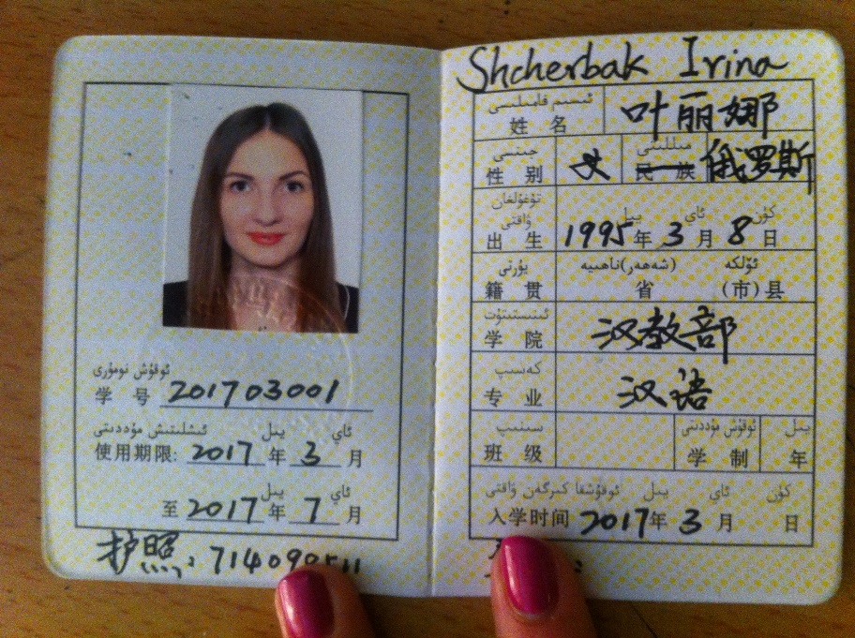
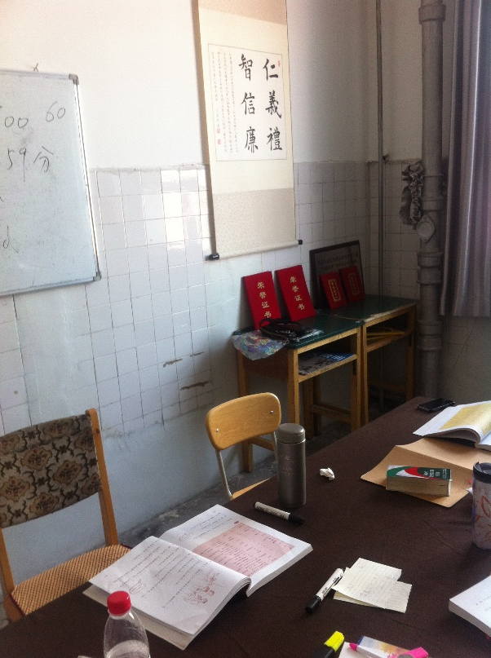
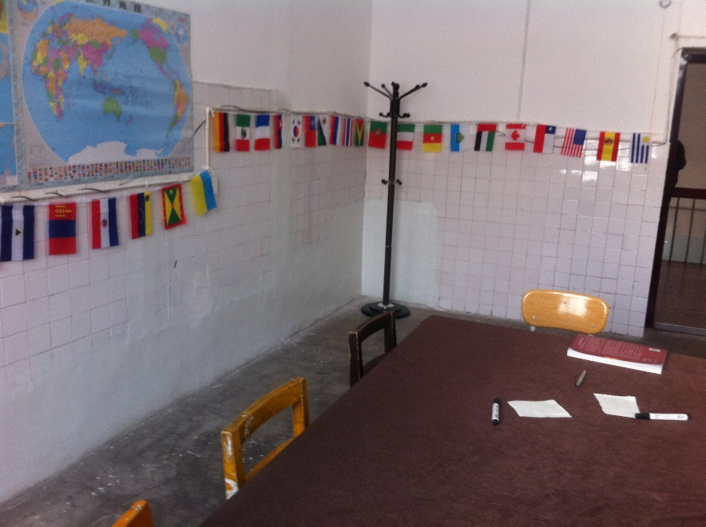
Study
学生证
I really like the process of studying Chinese in China because I can practice language all the time, and sometimes I even don’t have a choice - I need to speak. My group consists of me, the woman from Germany, man from the USA and guys from Kyrgyzstan and Ukraine. All of them are nice people.
Because of different language that we have we prefer mostly speaking English and Chinese. Therefore now I have a problem: sometimes languages mix In my head as I need to speak two foreign languages simultaneously. And often at first I remember a Chinese word or phrase.
教室

Slide 5
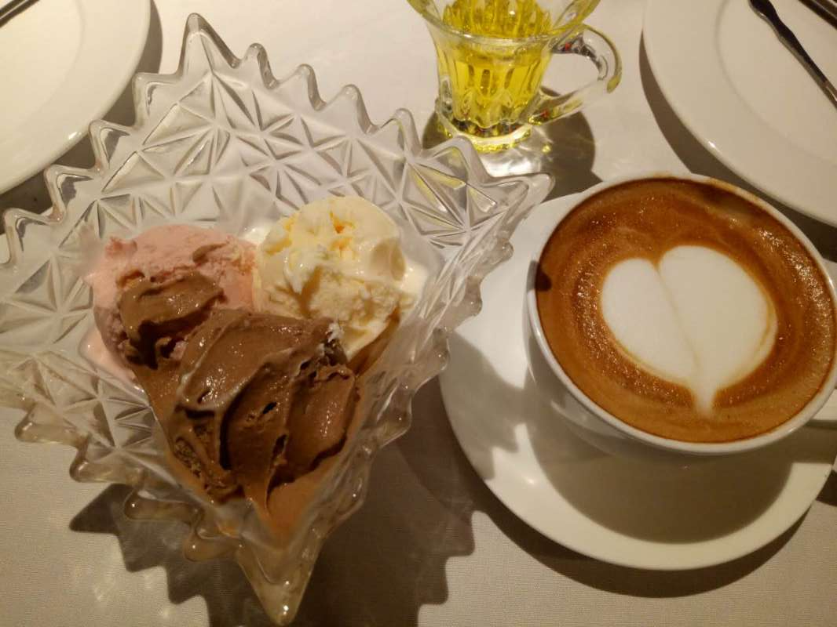
People
Chinese people are very friendly. And they really like Russians so it’s quite comfortable to live in China. Of course, I often hear something like (俄罗斯 or 老外 or 外国人) but I think that it’s because they don’t used to see lots of foreigners.
And Chinese often invite me for a lunch. As I don’t like Chinese food (I can’t eat rice at all, and fish and onion) they really try to order the dishes that I can eat. For example, on my birthday Ghalip with other 10 people from his office invited me in Chinese restaurant. Yesterday the one boy invited me in the European restaurant and I was so happy as I have an opportunity to eat pizza and ice cream, and drink a cup of coffee and use knife and fork!!! (我不喜欢用筷子吃饭). He works as a manager of personnel for ABC (Agricultural bank of China) so maybe he somehow can help me with my future work.

Slide 6
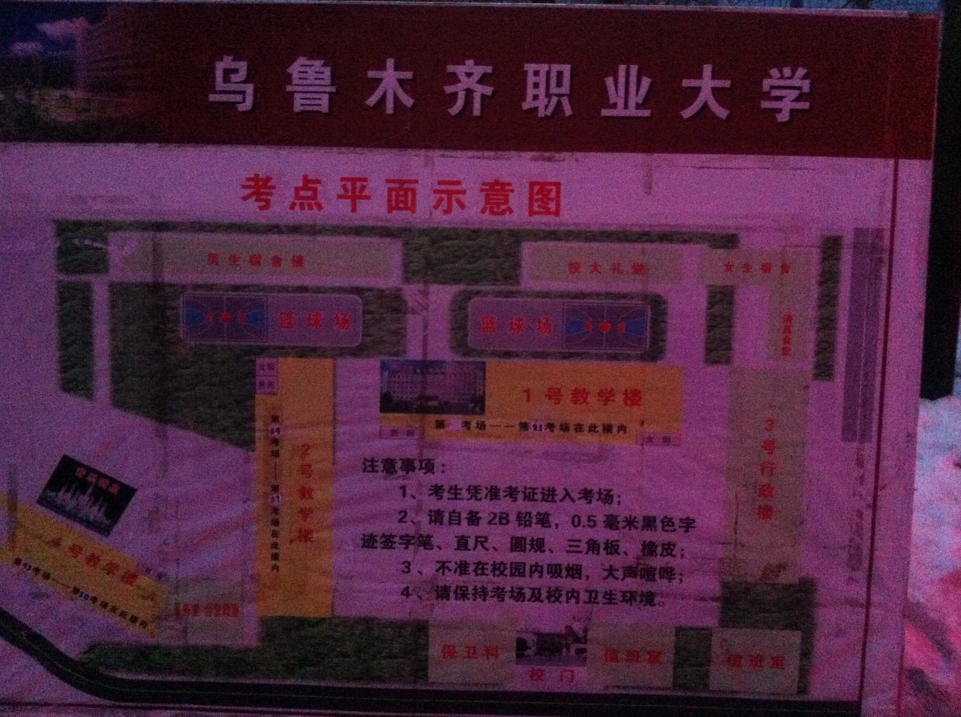
Plan of the University
乌鲁木齐职业大学大学 wūlǔmùqízhíyèdàxué - Urumqi professional university
考点平面示意图 kǎodiǎnpíngmiàn shìyìtú - Schematic map of the university
男生公寓楼 nánshēnggōngyùlóu – boy’s dormitory
女生公寓楼 nǔshēnggōngyùlóu – girl’s dormitory
篮球场 lánqiúchǎng - basketball court
一号教学楼 yī hàojiàoxuélóu – the first building of University (二/三 the second/ the third)

